Slide 2
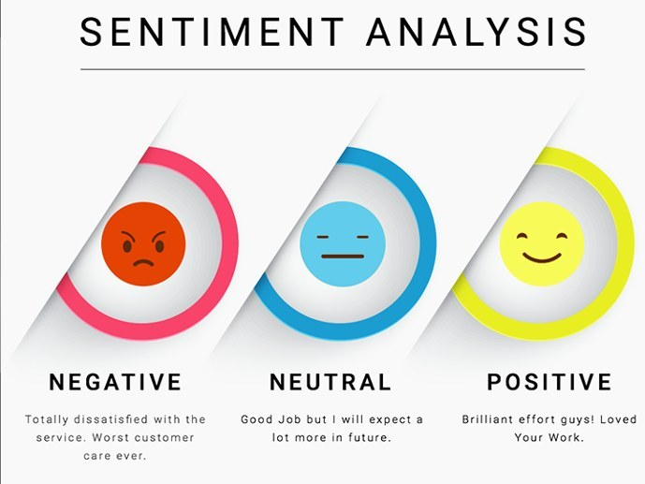
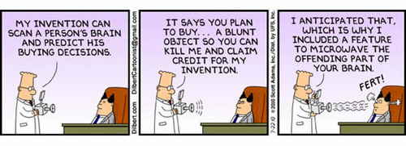
Sentiment Analysis
Sentiment Analysis (or Opinion Mining) is defined as the process of leveraging techniques such as NLP, text analysis, linguistics, lexical resources, and machine learning to systematically identify, extract, quantify, and study subjective information (mood, emotion)
Typically applied when the goal is to gauge customer sentiment towards a product, company, brand, or any subject matter of interest
Goes beyond traditional metrics (# of views, clicks)
to explore the quality of interactions between customers
and a brand
Conducted on vast collections of textual data based on reviews, surveys, social-media, web, forums, blogs, emails
One of the most active research areas in NLP. Research has slowly transitioned from computer science to management science and now social science
Notes:
Based on sentiment analysis, a company can reorganize its strategy based on customers reactions to specific events or marketing campaigns.

Slide 3
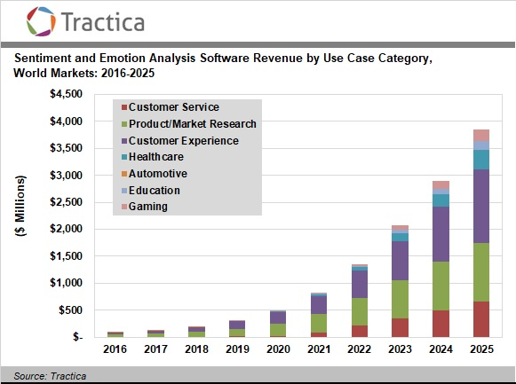
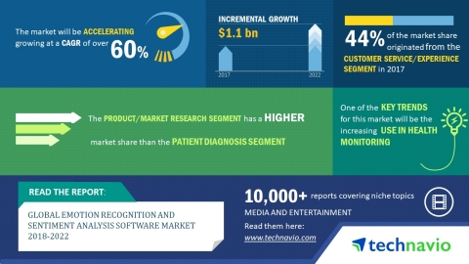
Sentiment Analysis Market

Slide 4
Sentiment Analysis Types
Sentiment analysis can be conducted on several levels: Sentence, paragraph, or entire document (more common)
Primary goal is to classify the textual documents into positive/negative sentiment based on polarity score.
Aspect-based sentiment analysis classifies not only sentiment, but also the target of sentiment (or opinion)
More advanced analyses focus on opinion summarization, intention mining, agreement/disagreement, and identifying fake opinions

Slide 5
Techniques for Sentiment Analysis
Unsupervised Knowledge-based models
Leverages Lexicons/databases
Supervised Models
Statistical models & Machine Learning
Hybrid Approaches
Combines the elements of both Machine Learning & knowledge representation

Slide 6
Unsupervised Lexicon based Models
Unsupervised models are based on well curated knowledgebases, lexicons, ontologies, and databases that have detailed information (sentiment, mood, polarity, subjectivity etc..) related to subjective words and phrases
Sentiment on a particular text document can be computed by matching the presence of words from the knowledge-bases and lexicons together with additional information pertaining to the presence of negation parameters, surrounding words, and contextual information
Lexicons are typically vocabularies of words specially constructed to compute sentiment without the need for any supervised techniques

Slide 7
Popular Lexicons/Databases for Sentiment Analysis
Several popular Lexicons:
AFINN Lexicon
SentiWordNet Lexicon
Vader Lexicon
Pattern Lexicon
Bing Liu Lexicon
MPQA Subjectivity Lexicon
Wordstat
SenticNet

Slide 8
Lexicons for Sentiment Analysis
Afinn Lexicon
Simplest and popular lexicons
3300+ words with polarity scores
Developed and curated by Arup Nielsen
Wrapper library in Python
SentiWordNet Lexicon
Popular lexicon based on WordNet synsets
NLTK library provides Python interface into SentiWordNet
Vader Lexicon
Rule based sentiment analysis specifically tuned for social media sentiment analysis
NLTK library provides Python interface

Slide 9
Supervised Models
Scrape, collect, retrieve textual data
Text Preprocessing
Convert to lowercase,
Remove html tags, Expand contractions
Remove punctuation, and stopwords
Stem or lemmatize
Feature Extraction
Bag of Words
Tf-IDF
Word2Vec
Apply Machine Learning models
Train/valid/test split
Train and evaluate models

